Slide 1
Statistics and Reliability: Module 13
Accelerated Life Testing Analysis (ALTA) Introduction
Notes:
Module Topics
Overview
First Steps from the ALTA 7 Software Training Guide (pages 9-16)
Accelerated Testing Demonstration
Step-by-Step Examples from the ALTA 7 Software Training Guide (as many as time permits)
Copyright (c) Deere & Company, as an unpublished work. This material is the property of Deere & Company. All use, disclosure, and/or reproduction not specifically authorized by Deere & Company is prohibited.

Slide 2
Stress Levels
Destruct Limits
Design Limits
s
s
e
r
Specification Limits
t
S
Design Limits
Destruct Limits
Notes:
Accelerated testing consists of a variety of test methods for decreasing the failure time of test items. It is used to quickly obtain data and save time () and money ($).
In order to accomplish this, test stresses should be chosen so that they accelerate the failure modes under consideration; however, test stress levels should not be chosen that introduce failure modes that would never occur under use conditions, e.g. material phase change.
Note: all non-field tests are accelerated in someway, but the acceleration factor is often not quantified, and, in some cases, it is equal to 1 if it perfectly replicates field conditions.

Slide 3
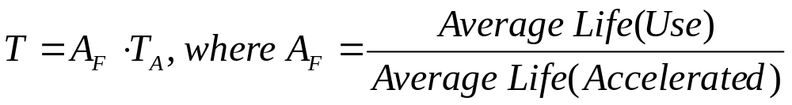
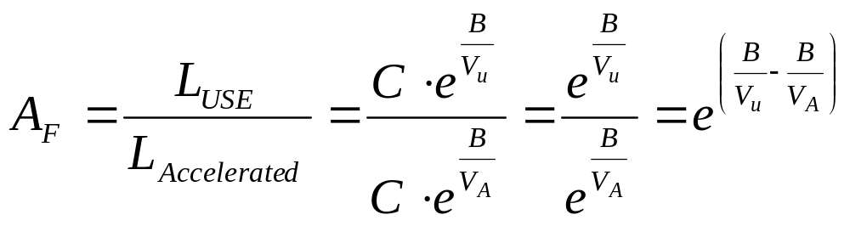
Time Acceleration
Arrhenius model
Notes:
Mathematically, T = A_{F} * T_{A}, where
T = Failure time under normal conditions (field use)
A_{F} = Acceleration factor
T_{A} = Failure time under accelerated conditions
The difficulty arises in determining “A_{F}”
Acceleration Factor Determination Methods
Use a physical model with a known slope parameter and extrapolate, e.g. Arrhenius model (shown above – compare to the parameterization in the equation on page 725)
Compare historical data of life performance in the field and on a test, i.e. correlation study
Use published values for similar products, e.g. MIL-STD-217
Conduct an experiment at 3 or more stress levels – ALTA is designed to analyze this data

Slide 4
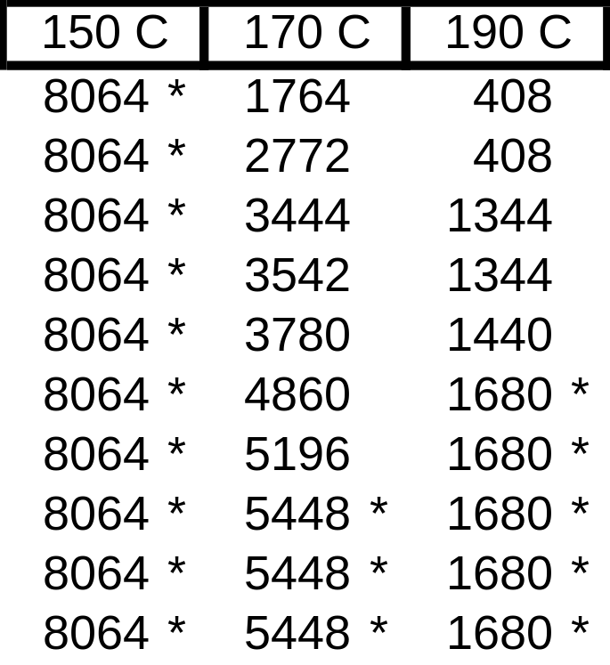
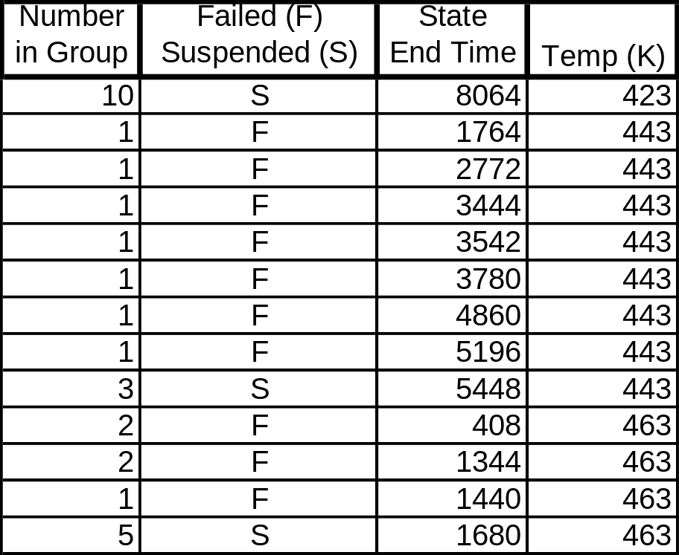
Example
Motor insulation life in hours at various test temperatures (Nominal = 100 C)
ALTA Data Format
* Denotes a suspension time
Notes:
The data arise from temperature accelerated life tests on electrical motor insulation. Ten motors were tested at each of three temperature levels, resulting in 12 failed units and 18 unfailed (i.e. censored) units.
The goal is to estimate B₁₀ at nominal temperature (100 C) - use 90% confidence.
[from Statistical Analysis of Reliability Data by M.J. Crowder, A.C. Kimber, R.L. Smith and T.J. Sweeting, page 134]

Slide 5
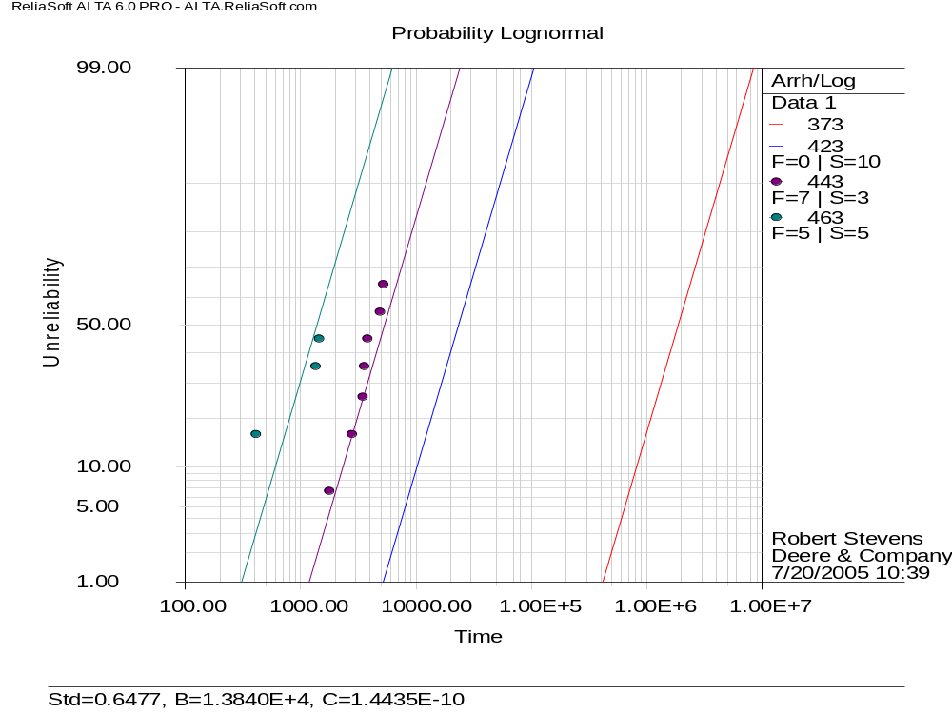
Notes:
Assumption of equal standard deviations (indicated by slope of the lines) appears to be valid.
There are more formal methods of checking this assumption (and they passed).

Slide 6
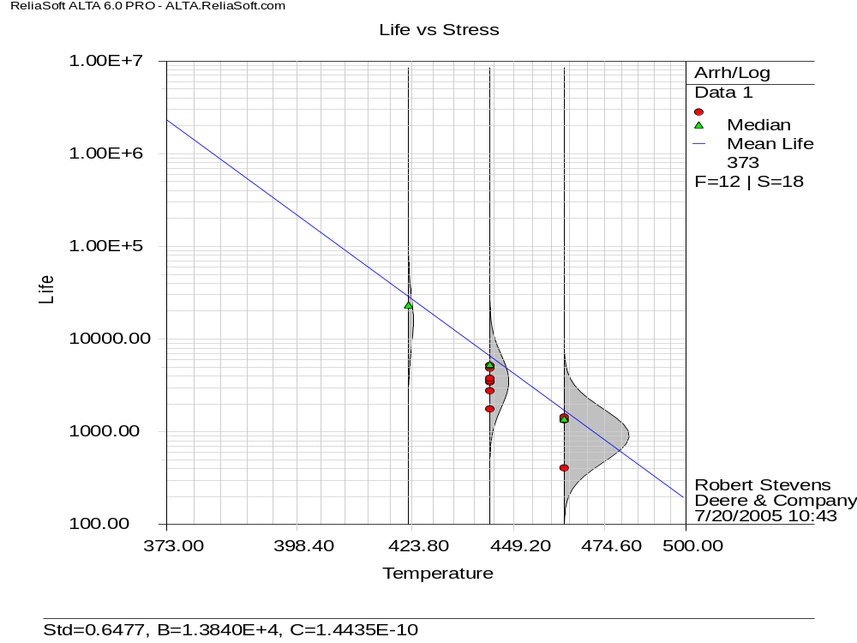
2,300,000
Notes:
The Mean Life projected to use conditions (100 C = 373 K) is around 2,300,000 hours.

Slide 7
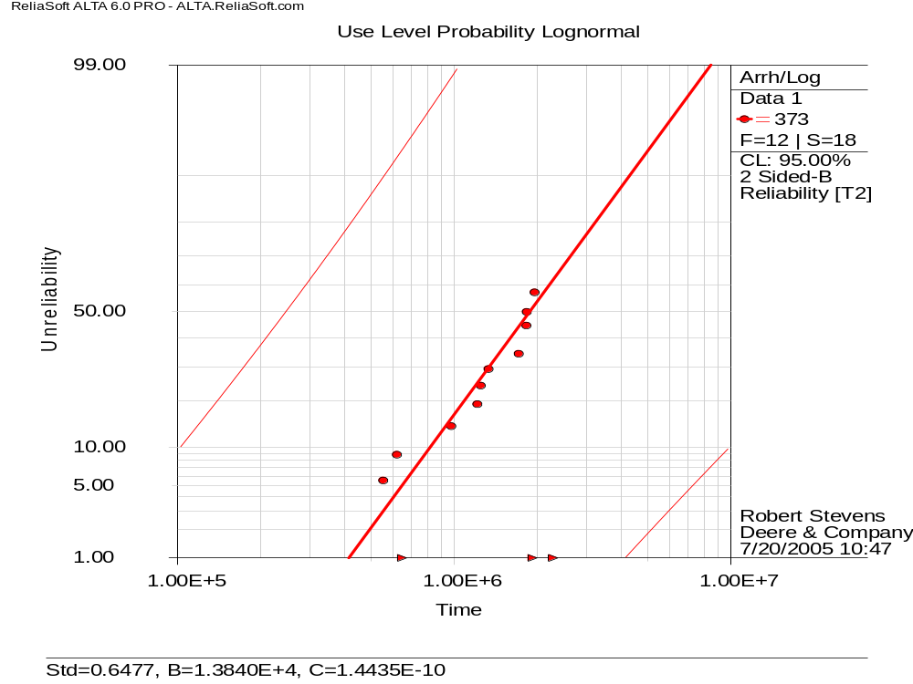
103,390
817,810
Notes:
Conclusions
The point estimate B₁₀ = 817,810 hours at 100 C.
The lower 90% confidence limit B₁₀ = 103,390 hours at 100 C.
This implies B₁₀ > 100,000 hours with 90% confidence at 100 C.

Slide 8
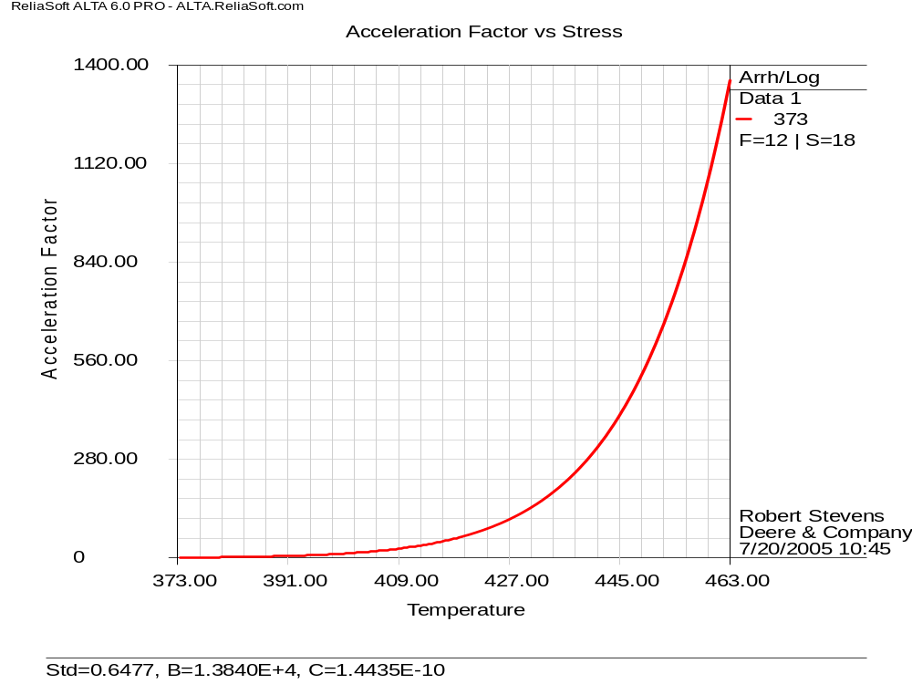
  (463, 1350)
  (443, 352)
  (423, 80)
Notes:
Conclusions
Acceleration factors from nominal temperature (373 K = 100 C)
80 @ 423 K = 150 C
352 @ 443 K = 170 C
1356 @ 463 K = 190 C
Note: this is similar to the plot shown in Figure 39.3 An example of the effects from activation energy assumptions but instead of activation energy being on the X- axis, temperature is shown.

Slide 9
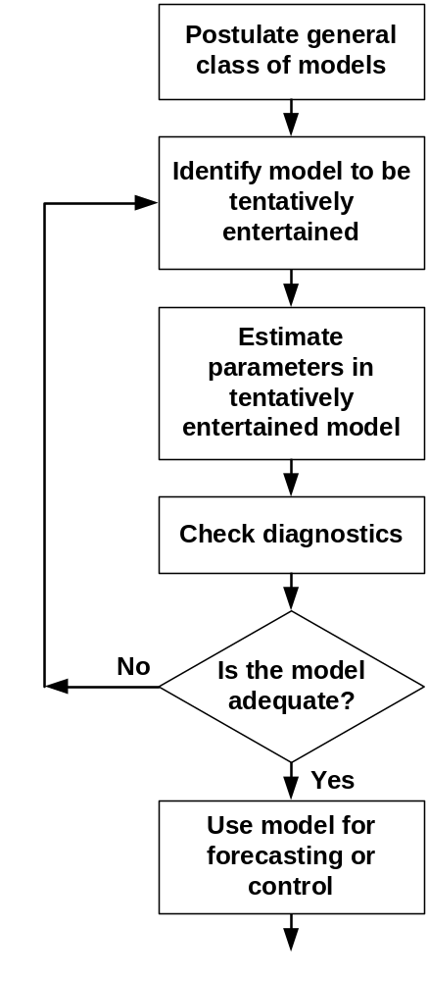
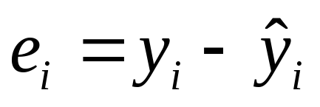
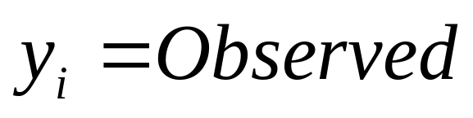
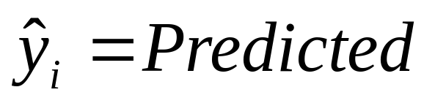
Stages in the Iterative Approach to Model Building *
Residuals ⇒
Notes:
Residual analysis involves the analysis of the results of the analysis by assigning residual values to each data point in the data set. Plotting these residuals provides a very good tool in assessing model assumptions and revealing inadequacies in the model, as well as revealing extreme observations.
We already did this in ANOVA, Regression and DOE, and we should do it with ALTA too.
* Time Series Analysis: Forecasting and Control, Box and Jenkins

Slide 10
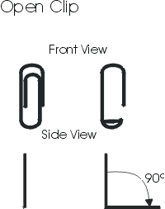
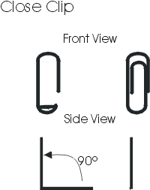
Accelerated Testing Demonstration
Notes:
Hold the clip by the longer, outer loop.
With the thumb and forefinger of the other hand, grasp the smaller, inner loop.
Pull the smaller, inner loop out and down 90° so that a right angle is formed as shown.
Continue to hold the clip by the longer, outer loop.
With the thumb and forefinger of the other hand, grasp the smaller, inner loop.
Push the smaller, inner loop up and in 90° so that the smaller loop is returned to the original upright position in line with the larger, outer loop as shown.
http://www.reliasoft.com/newsletter/1q2001/accelerated.htm

